Slide 1
FERMENTATION OF PENICILLIN ANTIBIOTIC

Slide 2
INTRODUCTION
Penicillin is an antibiotic produced by microorganisms.
The first antibiotic used in large amount during world war second for treatment of soldiers.
This antibiotics inhibit growth and development of other micro-organism.
Generally the penicillin antibiotic is produced by some actinomycetes and some filamentous fungi.
The antibiotics produced by these micro-organism can be used in medicine field, veterinary as well as agricultural field.
Can be used against Gram positive bacteria as well as high dosage can be used against Gram negative bacteria.
Penicillin is not harmful to plants, animals or human beings except in some cases of allergies.

Slide 3
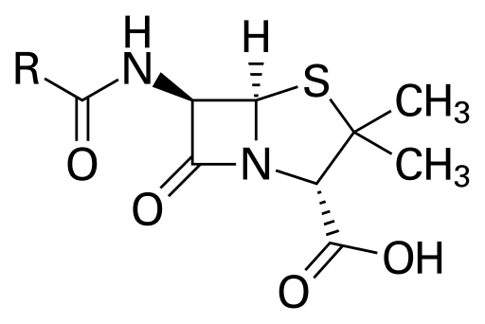
STRUCTURE OF PENICILLIN

Slide 4
PRODUCTION OF PENICILLIN
Penicillin fermentation is carried out anaerobically by submerged aerated fermentation process.
Fermentation medium
Fermentation organism
Inoculum preparation
Fermentation process
Recovery and Harvest of penicillin

Slide 5
1. Fermentation medium
Fermentation media used in penicillin fermentation should provide a sufficient amount of:
Carbon source
Nitrogen source
Nutrients
Amino-acids
Salts and
Precursors
The fermentation media should provide growth of mycelium, accumulation, extraction, purification of penicillin.
Exact composition of media used in industries are not know as it’s a matter of trade secrets.

Slide 6
Conti…
The raw material used in media as a source of nutrient are as follows.
Carbon source
Glucose
Lactose and
Sucrose
Nitrogen source
Ammonium sulphate
Ammonium acetate
Ammonium lactate

Slide 7
Conti….
Amino acids
Corn steep liquor.
Precursors for penicillin G
phenylacetic acid
Precursors for penicillin X
Hydroxyphenylacetic acid
Precursors for penicillin V
Phenoxyacetic acid.

Slide 8
2. Fermentation organism
Initially Penicillium notatum strain was used for fermentation of penicillin.
The results obtained by using this strain were not satisfactory so later a strain called Penicillium chrysogenum was discovered and it gave a greater yield.
The strain Penicillium chrysogenum gave a yield of 200 units/ ml.
Further this strain was improved by using strain improvement program and after strain improvement the strain gave a yield of 761 units /ml by using submerged cultured method.
This strain improvement is carried out by genetic mutation so this strain is highly unstable so this strain should be maintained properly.
The strain is maintained in dormant state by using lyophilization technique, stored in liquid nitrogen in frozen state or in spore form.

Slide 9
3. Inoculum preparation
In the process of innoculum preparation the pure culture of Penicillium chrysogenum is prepared in adequate amount for production of penicillin.
The primary stock is added in special agar the special agar should provide sporulation of spores the sporulating medium is used to prepare this working stock.
The sporulated spores are suspended in SLS solution that is sodium lauryl sulphonate in a proportion of 1:10,000 further this spores are added in a nutrient medium of wheat bran plus nutrient and the flask are incubated for 5 to 7 days at 24 ° C.
This medium is used for heavy sporulation.
Now this spores are used as a innoculum in fermentation tank.

Slide 10
4. Fermentation process
Fermentation of penicillin is carried out in trays or by submerged culture method.
The 10 % of inoculum is added in the fermenter (aseptically).
The temperature of about 25 ° C to 26 ° C is maintained.
The sterile air supply is provided continuously as the fermentation is aerobic fermentation.
The fermentation is carried out for about 3 to 5 days.

Slide 11
During this fermentation process the samples are withdrawn aseptically and checked for yield of penicillin, pH and contamination.
The checking for contamination is very important if the fermentation media gets contaminated by organism producing penicillinase enzyme then it can result in a great economic loss to industry.
The fermentation process is monitored for foam formation also if foam is produced it is controlled by antifoaming agent.

Slide 12
Initially the pH of fermentation media remain constant as the inoculum initially utilizes carbon as a source of energy but further when concentration of carbon is reduce the micro-organism starts utilization of nitrogen as a source of energy so at this point the pH of the fermentation media increases to 7.0 to 7.5 due to deamination and release of ammonia.
Now at this point the micro-organism starts product synthesis by utilization of lactose and production of penicillin.
After product formation the concentration of lactose is decreased and pH rises to 8 or even more which results in autolysis of mycelium.

Slide 13
Here at this point the fermentation is stopped and recovery and harvesting of product is started.
Initially during 20 to 30 hours the fungal spores utilizes carbohydrates and corn steep liquor and fungal spores develop as mycelium and further in the duration of 48 to 96 hours the mycelium starts production of penicillin product.
The yield obtained is 3 % to 5 % and 1500 unit per milliliter of fermentation medium.

Slide 14
5. Harvest and Recovery
Initially the mycelium and other solid suspended particles are removed by filtration process.
Further the filtrate is treated with solvent extraction procedure for separation of penicillin.
The penicillin is converted to anionic form by using phosphoric acid and sulphuric acid.
Further the broth is extracted by using a organic solvent like methyl isobutyl ketone or amyl acetate.

Slide 15
The extracted penicillin in solvent is back extracted in water by use of potassium hydroxide and sodium hydroxide in form of salt.
The aqueous penicillin is acidified and re-extracted by methyl isobutyl ketone.
This process of extraction of penicillin in water and organic solvents separates and purifies penicillin.
Further the aqueous penicillin is evaporated and crystallized in the form of sodium penicillin. Lastly this penicillin is standardised.

